Slide 1




Amazon Music Clustering
Domain : Music Analytics / Unsupervised Machine Learning
Business Use Cases:
Music Recommendations: Suggest similar songs within the same cluster.
Playlist Generation: “Discover ‘Chill Vibes’ or ‘Workout Beats’ automatically.”
Trend Analysis: Identify popular audio feature patterns over time.
Marketing: Help Amazon Music curate themed playlists for users.
Data Set Explanation:
This dataset provides audio characteristics of Amazon Music songs that define how a song "sounds." These include rhythm, mood, intensity, and instrumentation
Presented BY: M. Keerthana

Slide 2
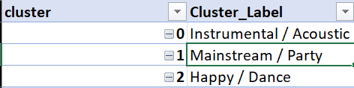
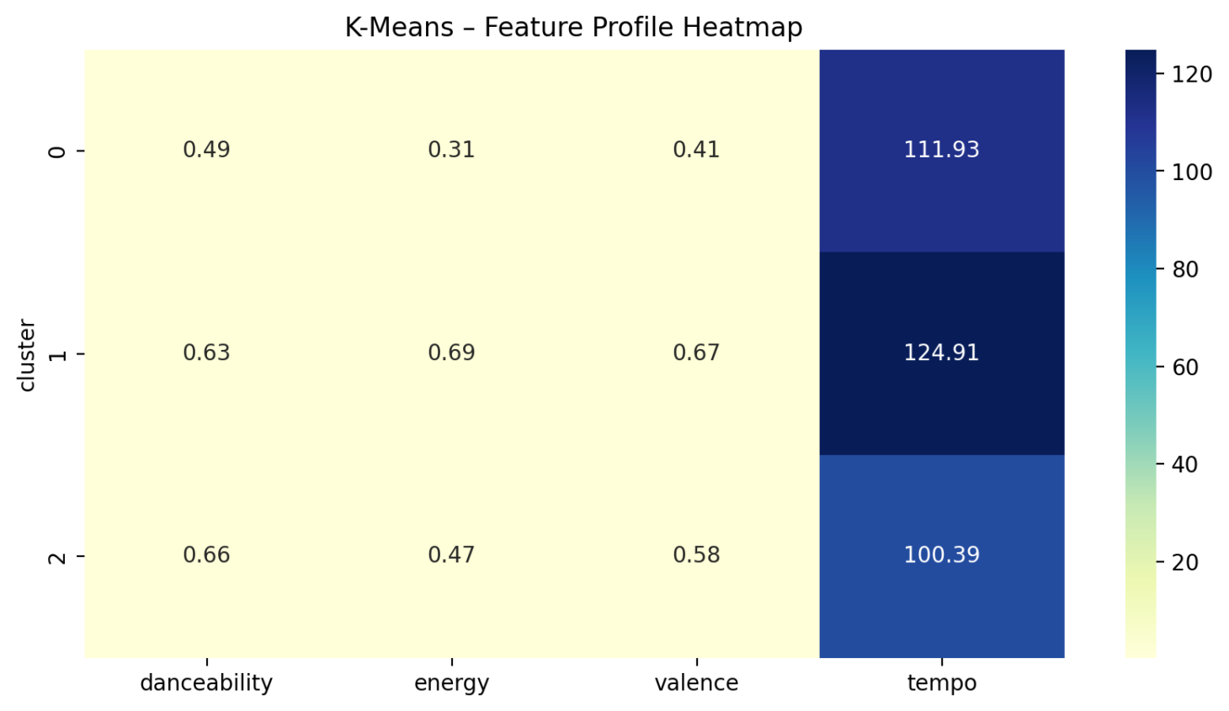
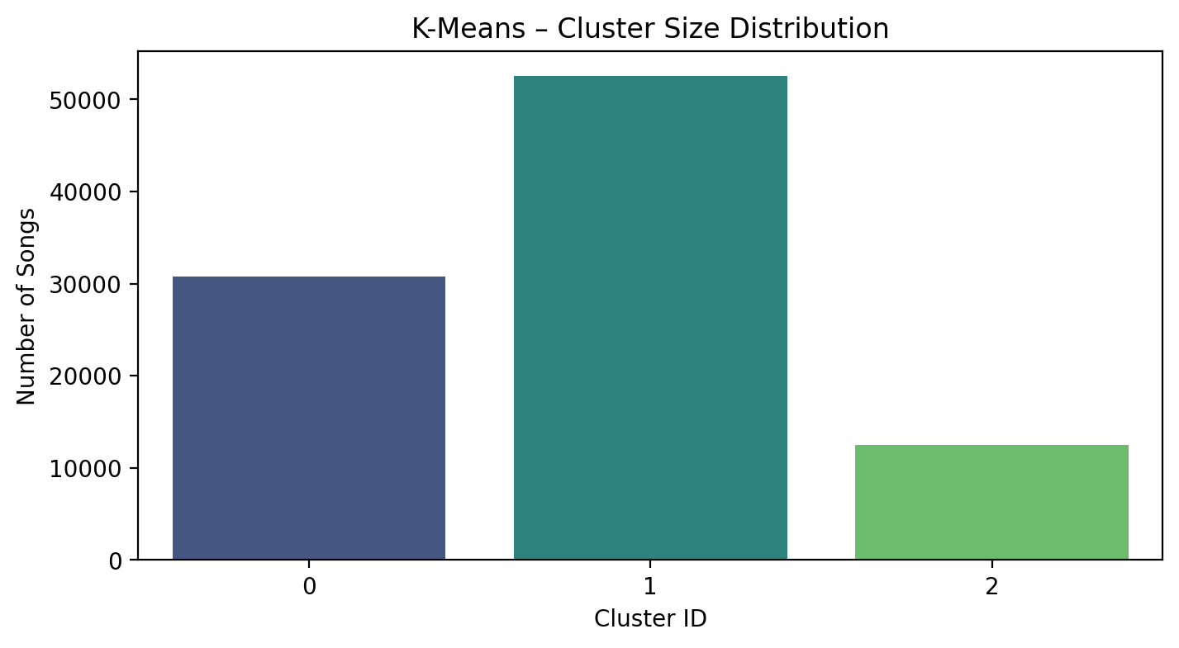
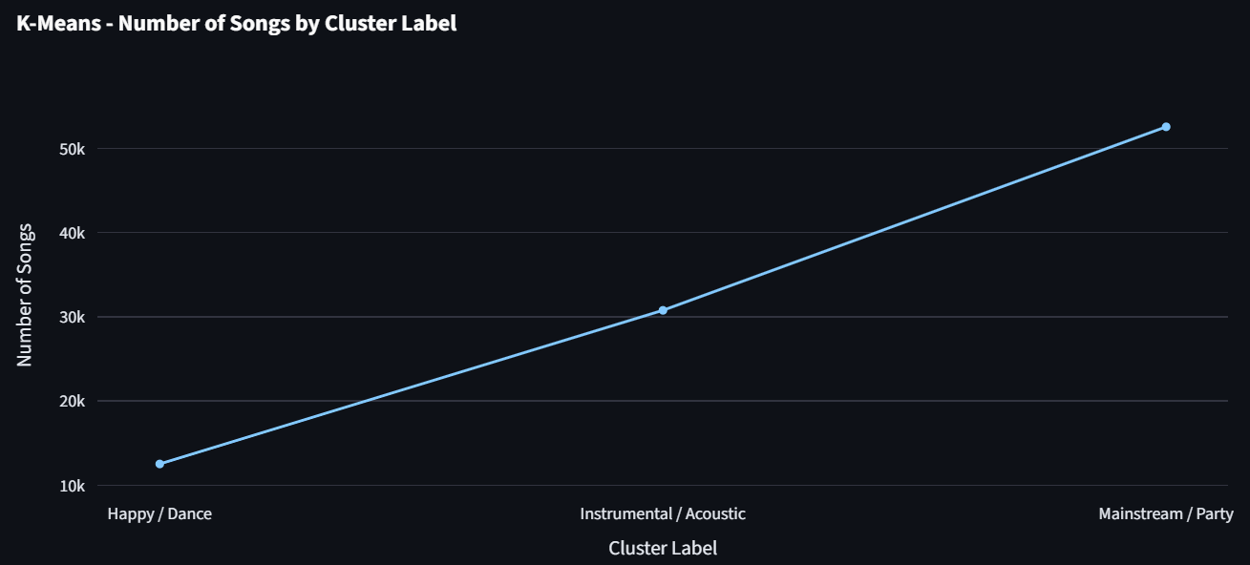
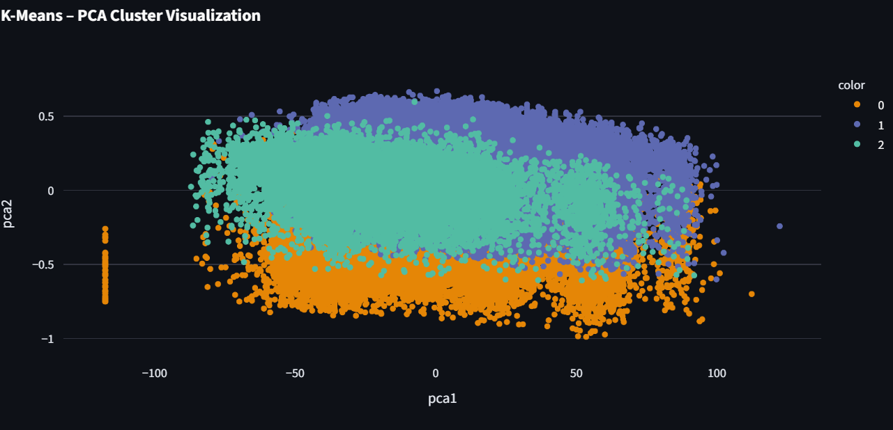
K-Means Cluster Distribution
Key Insights
3 clusters of songs discovered using K-Means
Cluster 0: Low energy, soft/acoustic songs
Cluster 1: High energy, upbeat, danceable songs
Cluster 2: Moderate tempo, balanced mood
PCA plot shows clear separation → clustering meaningful
Useful for playlist generation & recommendations

Slide 3
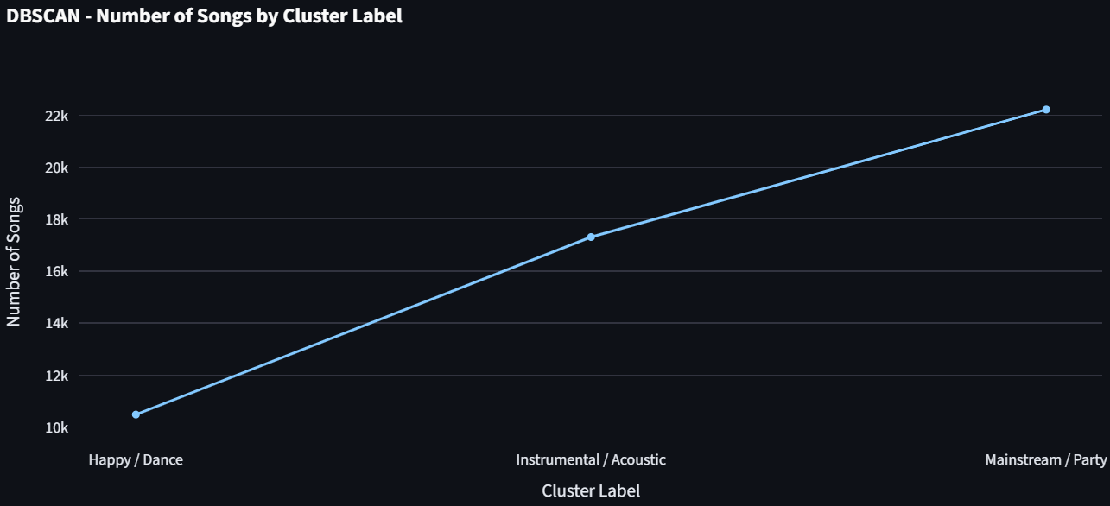
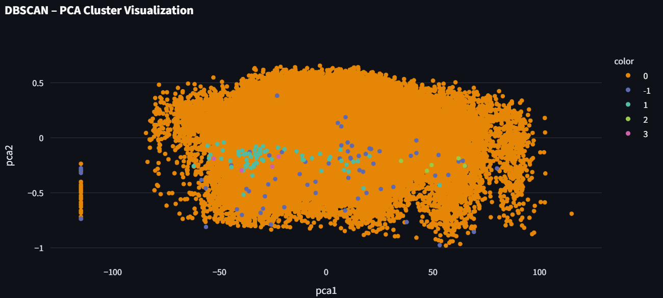
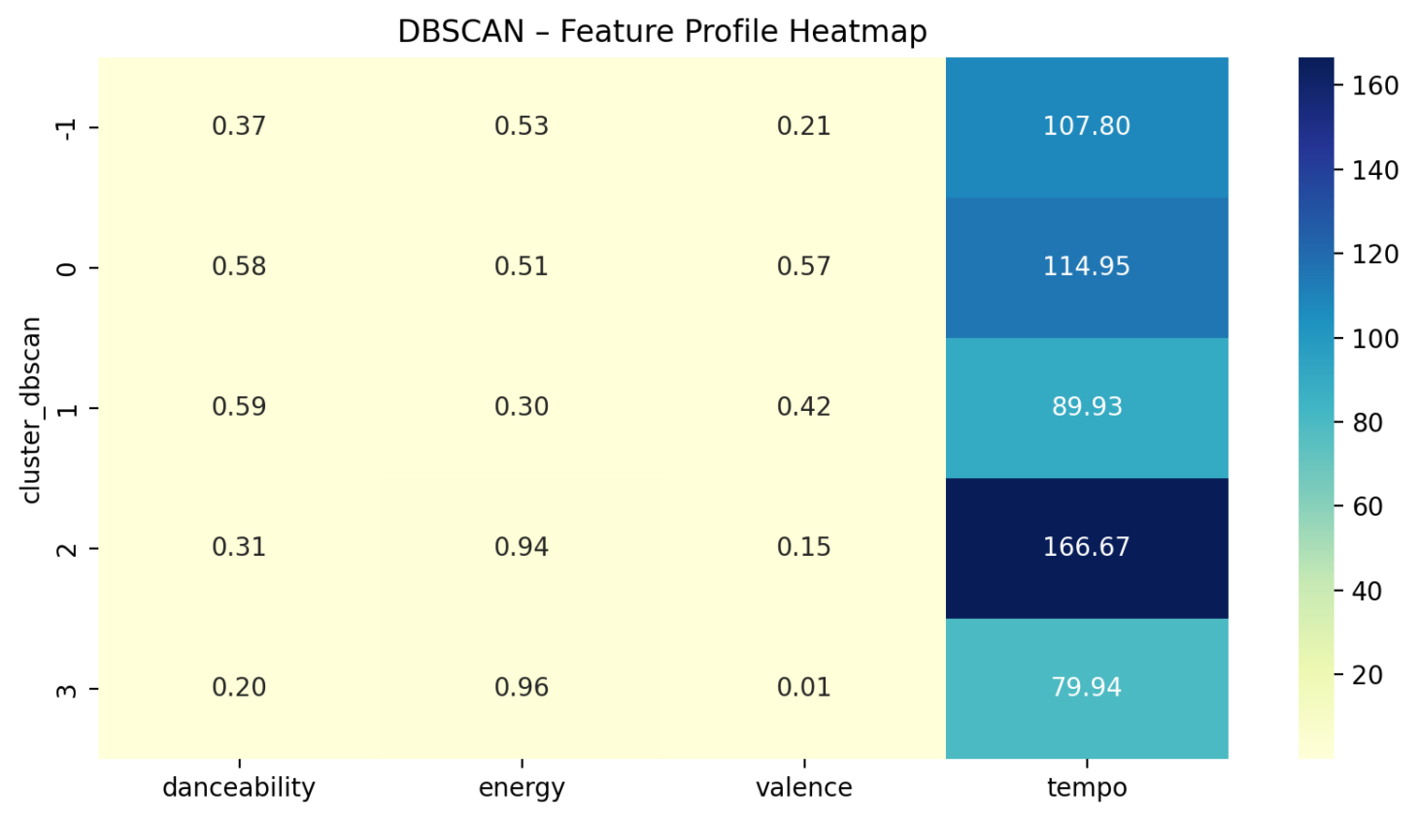
DBSCAN Cluster Distribution
DBSCAN identified clusters of songs based on density without predefining the number of groups — revealing natural patterns in the Amazon Music dataset.
The majority of songs belong to one dense cluster (balanced, mainstream tracks), while smaller clusters represent niche styles like high-energy dance music or slow acoustic songs.
DBSCAN effectively detected “noise” points — songs that don’t fit into any cluster — highlighting rare or experimental tracks that K-Means might overlook.

Slide 4
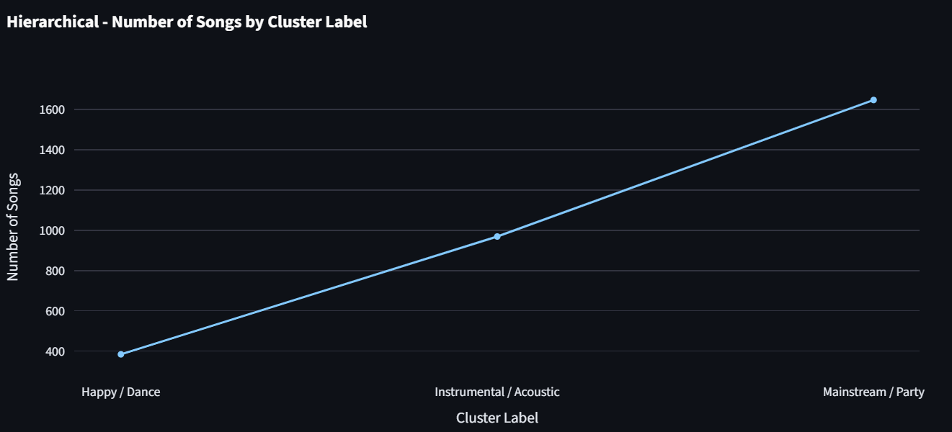
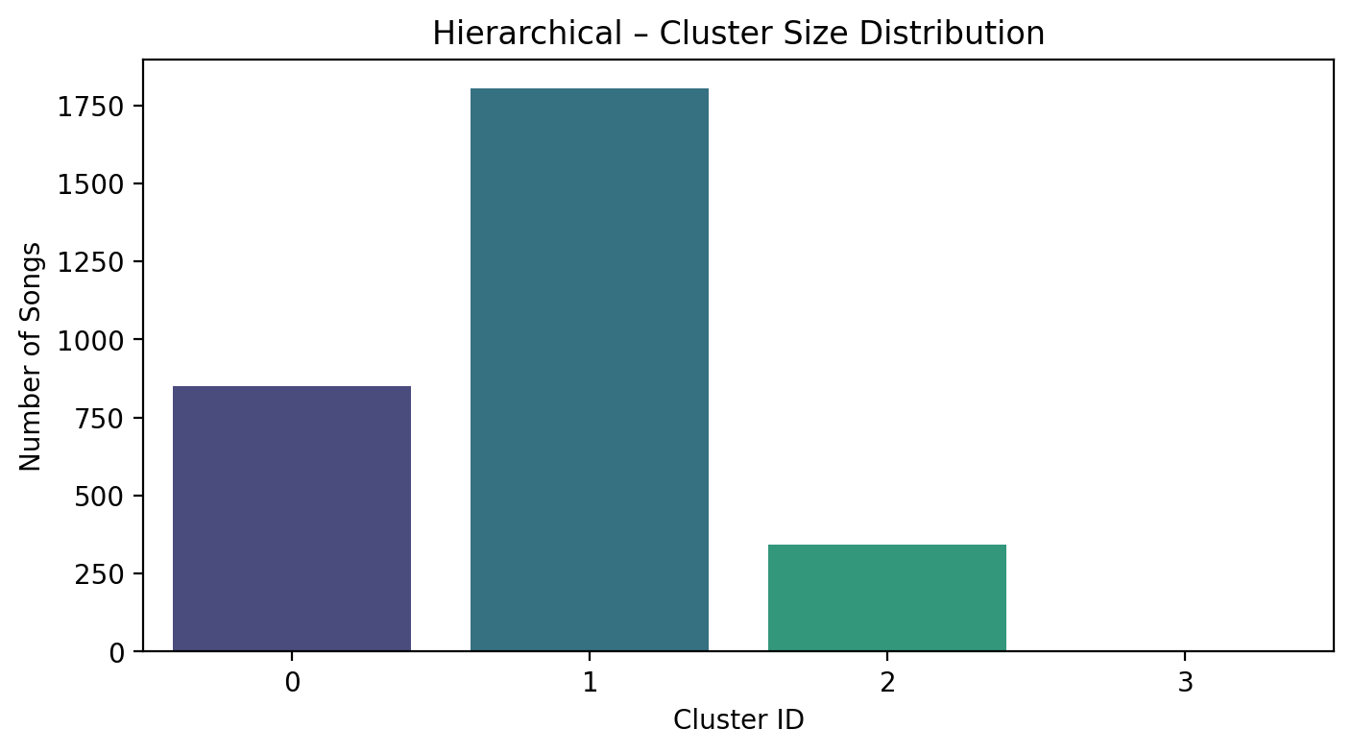
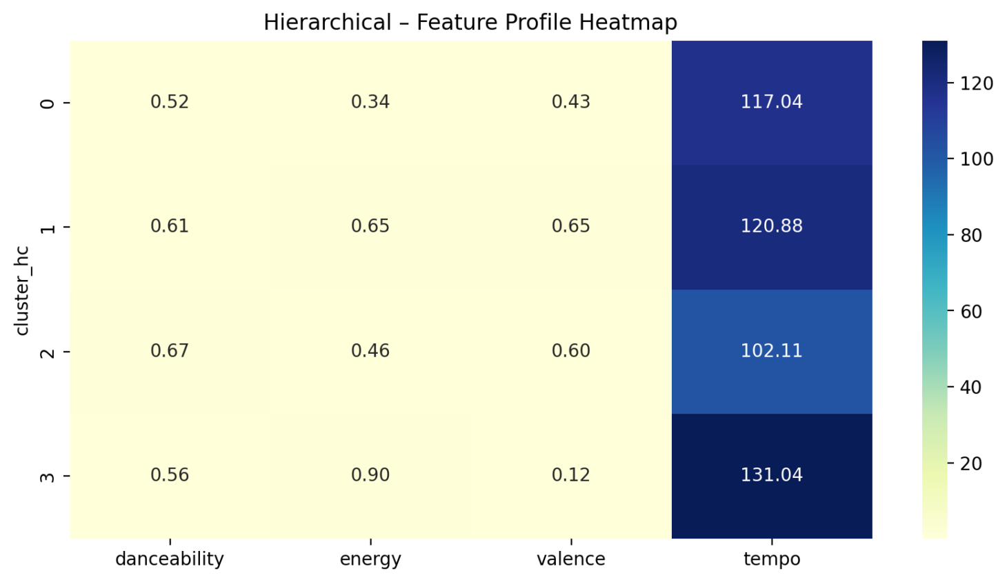
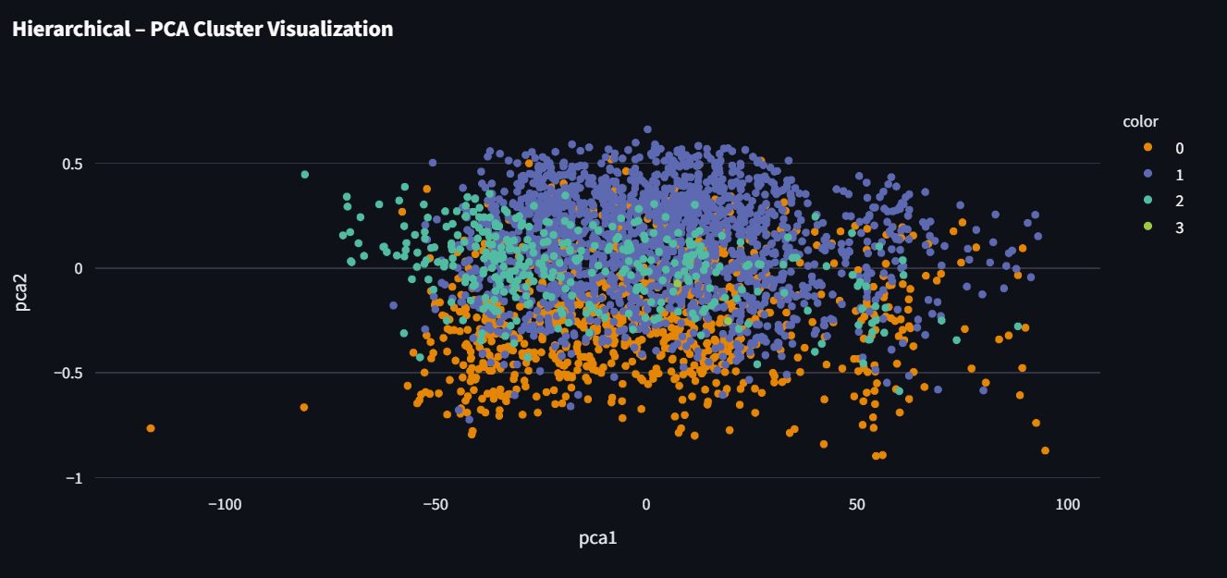
Hierarchical Cluster Distribution
Hierarchical clustering revealed four main song clusters that differ in energy, tempo, and mood — from chill acoustic tracks to fast, high-energy dance songs.
The largest cluster represents balanced, mid-tempo pop-style tracks, reflecting the mainstream nature of most songs in the dataset.
The clusters form a natural gradient from low-energy acoustic music to high-energy, high-tempo tracks — mirroring real-world listening preferences and playlist categories.

Slide 5
